Slide 1



Epoch-10 autoencoders
Fruitpunch.ai/code
15-10-2019
Roxanne boehlé

Slide 2
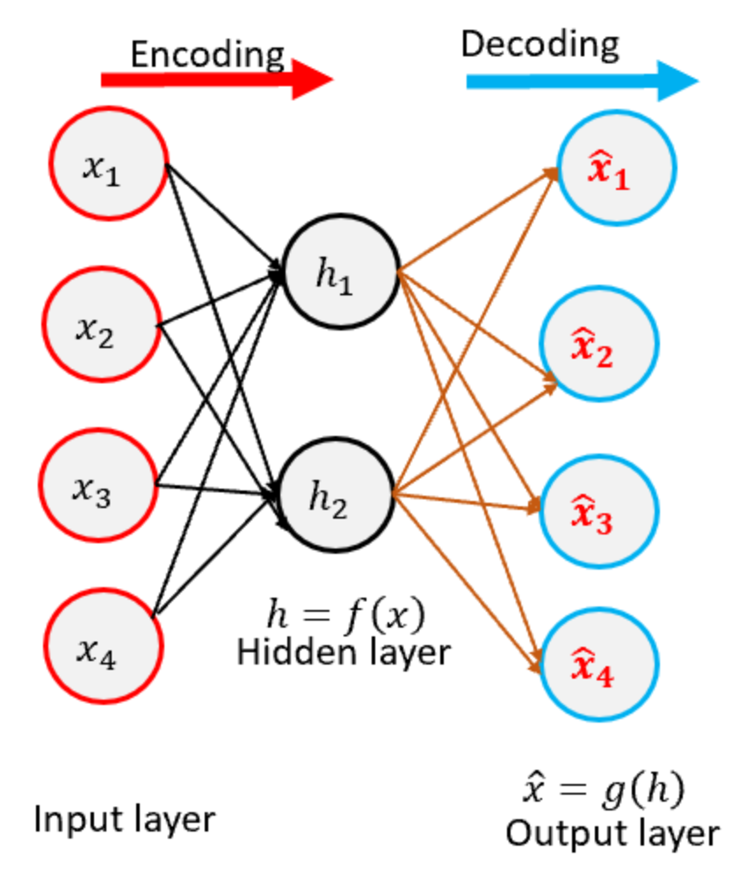
What are autoencoders?
Autoencoders are a specific type of feedforward neural networks where the input is the same as the output. They compress the input into a lower-dimensional code and then reconstruct the output from this representation. The code is a compact “summary” or “compression” of the input, also called the latent-space representation.
While minimizing reconstruction error between the input and output.

Slide 3
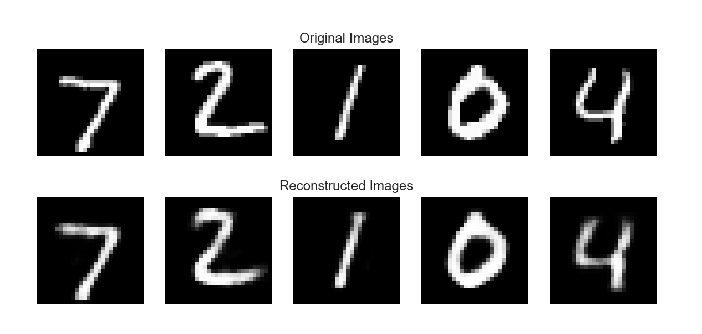
The challenge: convolutional autoencoder
https://github.com/fruitpunch-ai-code/epoch-10
Hard challenge: design your own autoencoder for MNIST
Normal challenge: design the decoder part of the given convolutional encoder

Slide 4
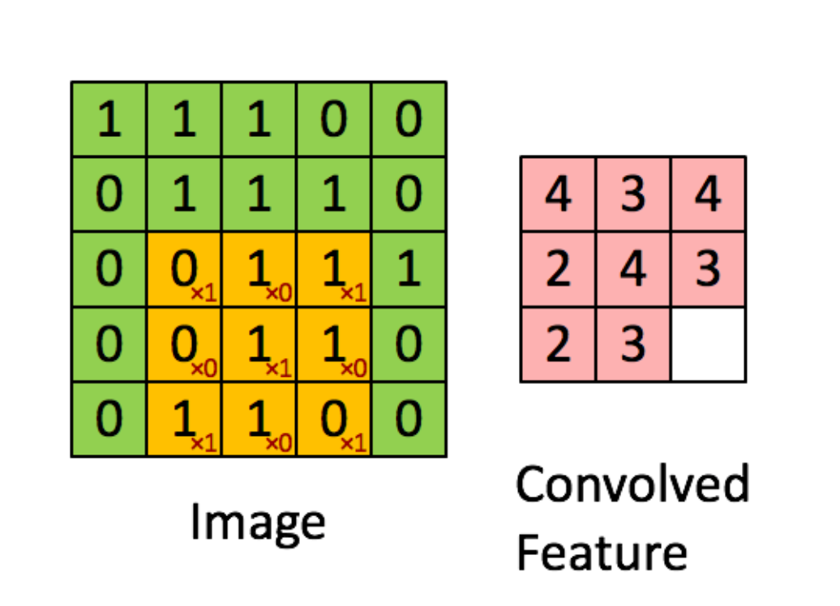
What do you mean, convolutional?
If you do not know what a CNN is, do some research yourself before starting the challenge.
Decoding an encoded CNN does not prefer deconvolution layers.

Slide 5
Inverting convolutional layers
Dealing with this is challenging due to the overlapping of kernels
Intuitively you include deconvolutional layers since this is inverting a CNN layer
Leads to generating checkboard artifacts
Try UpSampling and simple convolutional layers instead

Slide 6
Helpful links
https://medium.com/datadriveninvestor/deep-learning-autoencoders-db265359943e
https://towardsdatascience.com/applied-deep-learning-part-3-autoencoders-1c083af4d798
https://towardsdatascience.com/aligning-hand-written-digits-with-convolutional-autoencoders-99128b83af8b
Or search for CNN, autoencoders, MNIST, UpSampling, MaxPooling, Dense, Flatten, Reshape, BatchNormalization for more inspiration

